Slide 1
Introduction to HCI
Human Computer Interaction
CIS 4930/6930
Section 1185/4198

Slide 2
Class Goals
Motivate the field of HCI
Learn
  Basics of interface design
  Evaluation of interfaces
  HCI research problems
  HCI community (conferences and people)

Slide 3
What the class will look like
Lectures
Readings + Quizzes + Presentations (?)
Initial user study (web interface comparison)
Final project
  Identify a client
  Create a new interface
  Evaluate the interface
Differences between undergrad/grad
  Project requirements

Slide 4
Why take this course?
Build your portfolio
  Work on a project you’ve always wanted
Study a unique topic
  A computer science course focused on users
Skill building
  Important in most research
  Burgeoning job field

Slide 5
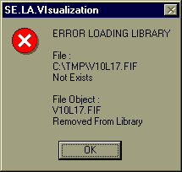
Intro
What is a user interface?
Why do we care about design?
We see this all the time.
  What’s good about the design of this error box?
    The user knows there is an error
  What’s poor about the design of this error box?
    Discouraging
    Not enough information
    No way to resolve the problem (instructions or contact info)

Slide 6
Definition of HCI
Human-computer interaction is a discipline concerned with the design, evaluation and implementation of interactive computing systems for human use and with the study of major phenomena surrounding them.
ACM SIGCHI Curricula for HCI (Hewett et al. 1992)
http://sigchi.org/cdg/cdg2.html

Slide 7
Why HCI is Important
The study of our interface with information.
It is not just ‘how big should I make buttons’ or ‘how to layout menu choices’
It can affect
  Effectiveness
  Productivity
  Morale
  Safety
Example: a car with poor HCI
Take 5 minutes for everyone to write down one common device with substantial HCI design choices and discuss with the neighbor the pros and cons. How does it affect you or other users?

Slide 8
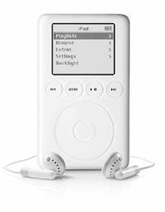
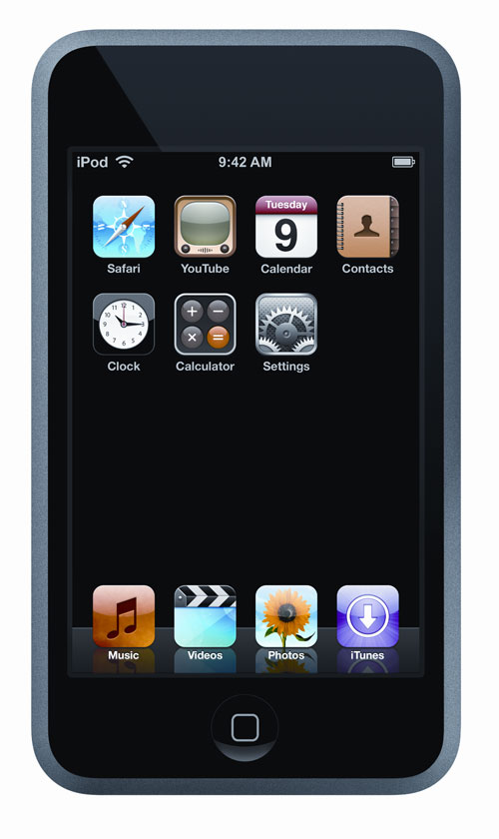
My Choice
iPod by Apple Computers
Pros:
  portable
  power
  ease of use
  # of controls
Cons:
  scratches easily
  no speech for car use
  proprietary

Slide 9
What fields does HCI cover?
Computer Science
Psychology (cognitive)
Communication
Education
Anthropology
Design (e.g. graphic and industrial)

Slide 10
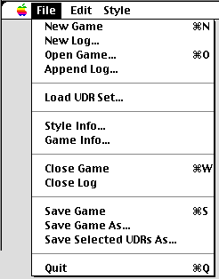
HCI Community
Academics/Industry Research
  Taxonomies
  Theories
  Predictive models
Experimenters
  Empirical data
  Product design
Other areas (Sociologists, anthropologists, managers)
  Motor
  Perceptual
  Cognitive
  Social, economic, ethics

Slide 11
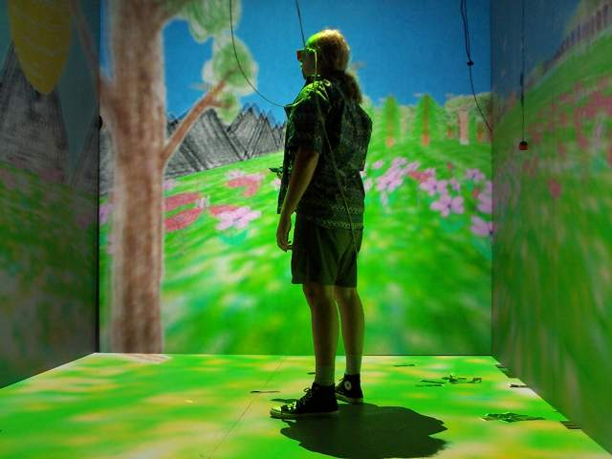
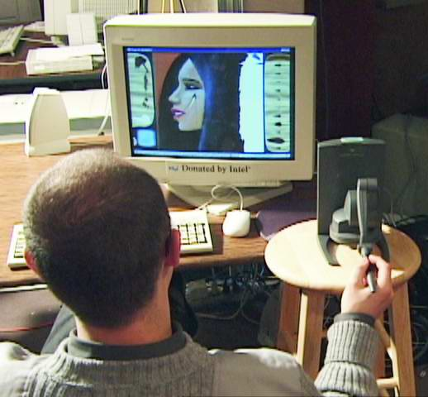
HCI Tools
Sound
3D
Animation
Video
Devices
  Size (small->very large)
  Portable (PDA, phone)
  Plasticity
Context sensitive/aware
Personalizable
Ubiquitous

Slide 12
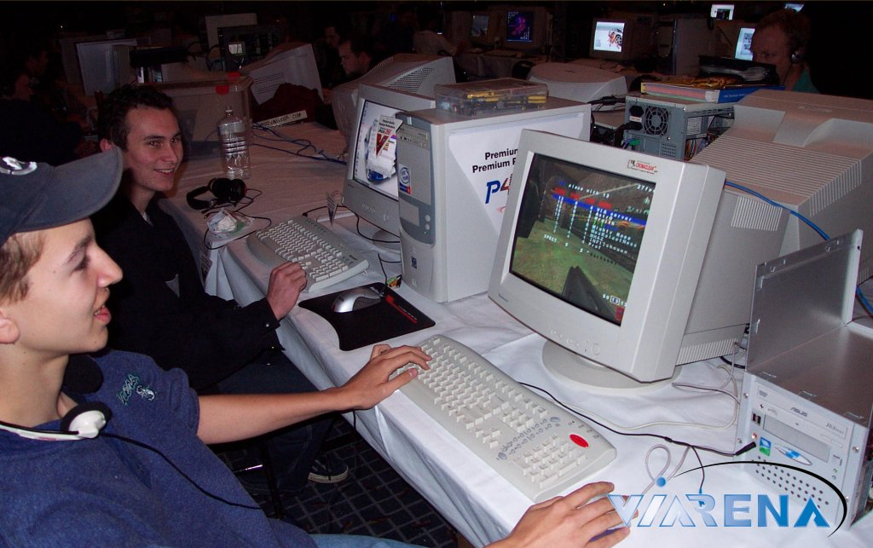
Usability Requirements
Goals:
  Usability
  Universality
  Usefulness
Achieved by:
  Planning
  Sensitivity to user needs
  Devotion to requirements analysis
  Testing

Slide 13
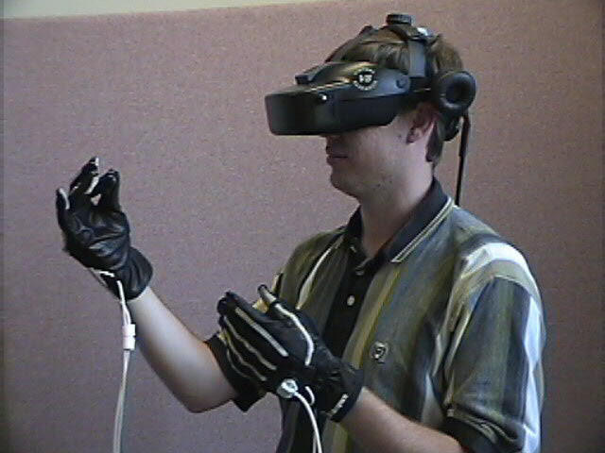
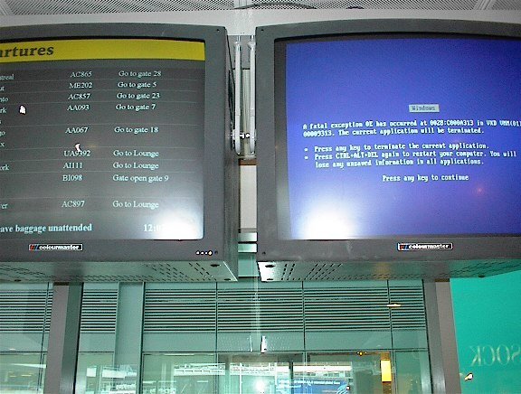
Bad Interfaces
Encumbering
Confusing
Slow
Trust (ex. windows crashing)
What makes it hard?
  Varies by culture
  Multiple platforms
  Variety of users

Slide 14

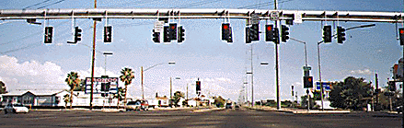
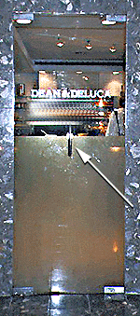
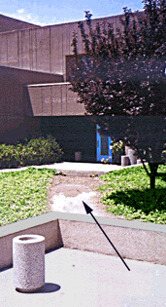

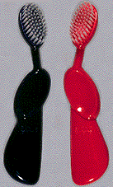

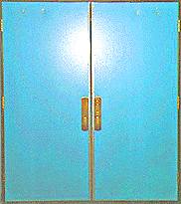
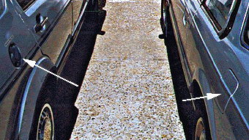
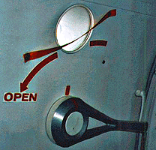
What’s wrong with each?
  Type of error
  Who is affected
  Impact
What’s a redesign solution?

Slide 15
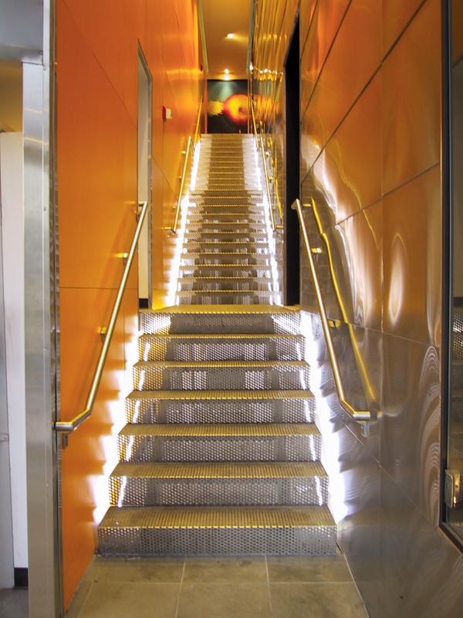
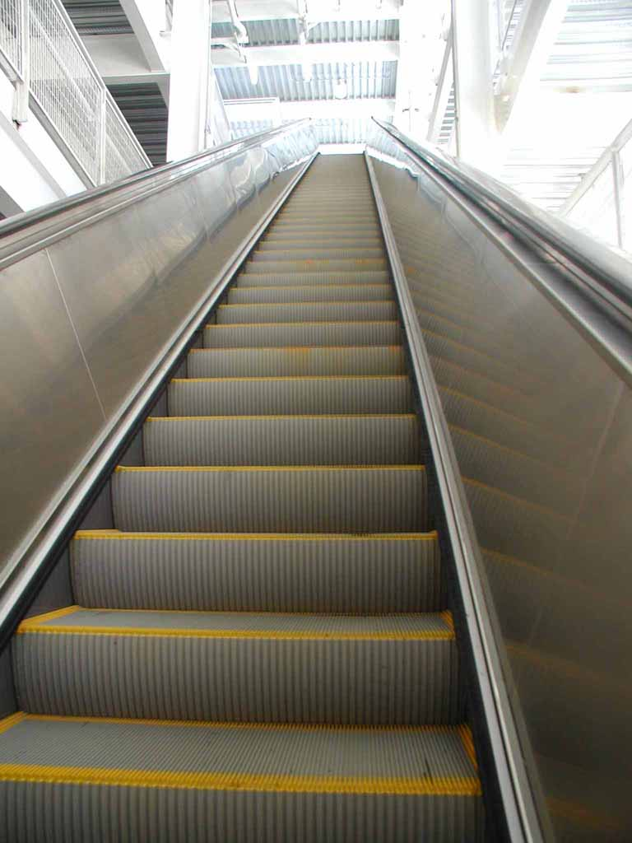
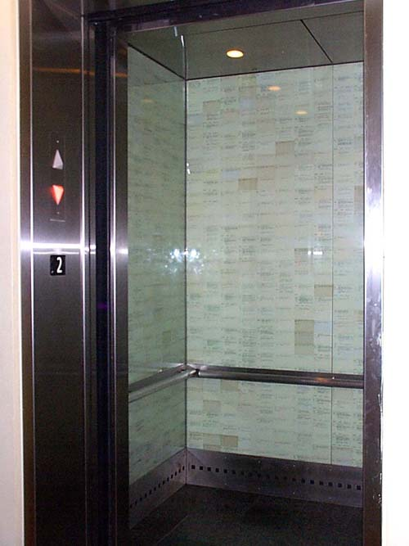
Requirements Analysis
Ascertain users’ needs
Ensure proper reliability
Promote appropriate standardization, integration, consistency, and portability
Complete projects on schedule and within budget

Slide 16
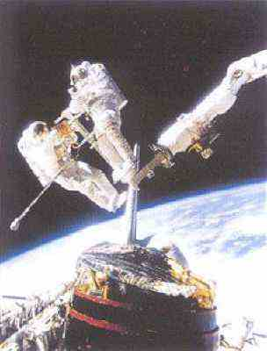
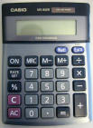
Ascertain User’s Needs
Define tasks
  Tasks
  Subtasks
Frequency
  Frequent
  Occasional
  Exceptional
  Repair
Ex. difference between a space satellite, car engine, and fighter jet

Slide 17
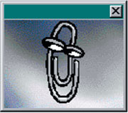
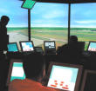
Reliability
Actions function as specified
Data displayed must be correct
Updates done correctly
Leads to trust! (software, hardware, information) – case: Pentium floating point bug
Privacy, security, access, data destruction, tampering

Slide 18
Standardization, Integration, Consistency, Portability
Standardization – common user-interface features across multiple applications
  Apple
  Web
  Windows
Integration – across application packages
  file formats
Consistency – common action sequences, terms, units, layouts, color, typography within an application
Portability – convert data and interfaces across multiple hardware and software environments
  Word/HTML/PDF/ASCII

Slide 19
Case Study: Library of Congress Database Design
http://catalog.loc.gov/
Two interfaces
  Catalog New Books
    3-6 hour training course - staffers
  Search Catalog of Books
    General public – too complex, command language and complex cataloging rules
Solution
  Touch screen
  Reduced functionality
  Better information presentation
Eventually Web based interface
Same database and services, different interfaces

Slide 20

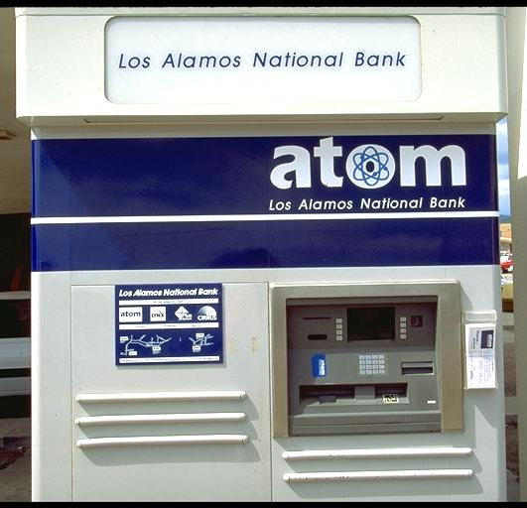
Usability Measures
How can we measure the ‘goodness’ of an interface?
What are good metrics?
ISO 9241
  Effectiveness
  Efficiency
  Satisfaction
Schneiderman
  Time to learn
  Speed of performance
  Rate of errors
  Retention over time
  Subjective satisfaction

Slide 21
Usability Motivations
Time to learn
Speed of performance
Rate of errors
Retention over time
Subjective satisfaction
Life-Critical systems
  Applications: air traffic, nuclear reactors, military, emergency dispatch
  Requirements: reliability and effective (even under stress)
  Not as important: cost, long training, satisfaction, retention
Industrial and Commercial Use
  Applications: banking, insurance, inventory, reservations
  Requirements: short training, ease of use/learning, multiple languages, adapt to local cultures, multiplatform, speed
Office, Home, and Entertainment
  Applications: E-mail, ATMs, games, education, search engines, cell phones/PDA
  Requirements: Ease of learning/use/retention, error rates, satisfaction
  Difficulties: cost, size

Slide 22
Usability Motivations
Time to learn
Speed of performance
Rate of errors
Retention over time
Subjective satisfaction
Exploratory, Creative, Collaborative
  Applications: Web browsing, search engines, simulations, scientific visualization, CAD, computer graphics, music composition/artist, photo arranger (email photos)
  Requirements: remove the ‘computer’ from the experience,
  Difficulties: user tech savvy-ness (apply this to application examples)
Socio-technical systems
  Applications: health care, voting, police
  Requirements: Trust, security, accuracy, veracity, error handling, user tech-savy-ness

Slide 23
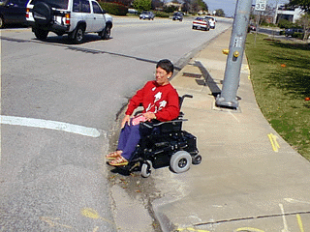
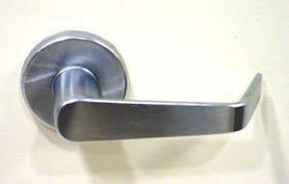
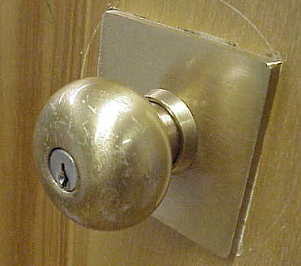
Universal Usability
Interface should handle diversity of users
  Backgrounds
  Abilities
  Motivation
  Personalities
  Cultures
Question, how would you design an interface to a database differently for:
  A. right-handed female, Indian, software engineer, technology savvy, wants rapid interaction
  B. left-handed male, French, artist

Slide 24
Universal Usability
Does not mean ‘dumbing down’
  Ex. Helping disabled has helped others (parents w/ strollers, elderly)
  Ex. Door handles
Goal: Address the needs of more users - unlike yourself!
Everyone is often not at full faculties at all times

Slide 25
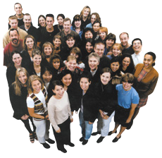
Physical Variation
Ability
  Disabled (elderly, handicapped, vision, ambidexterity, ability to see in stereo [SUTHERLAND])
  Speed
  Color deficiency
Workspace (science of ergonomics)
  Size
  Design
Lots of prior research

Slide 26
Physical Variation
Field of anthropometry
  Measures of what is 5-95% for weight, height, etc. (static and dynamic)
  Large variance reminds us there is great ‘variety’
  Name some devices that this would affect.
    note most keyboards are the same
    screen brightness varies considerably
    chair height, back height, display angle
Multi-modal interfaces
    Audio
    Touch screens

Slide 27
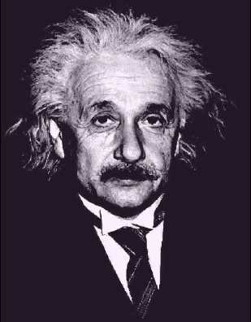
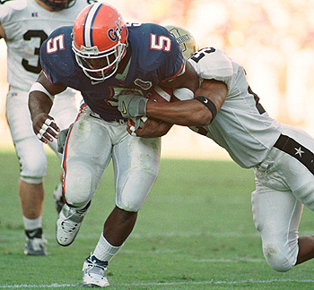
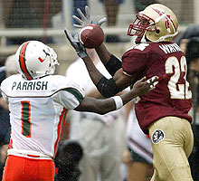
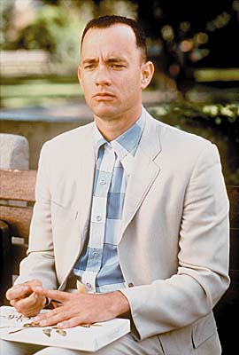
Cognitive and Perceptual Variation
Bloom’s Taxonomy
  knowledge, comprehension, analysis, application, synthesis, evaluation
Memory
  short-term and working
  long-term and semantic
Problem solving and reasoning
Decision making
Language and communication

Slide 28
Cognitive and Perceptual Variation
Language and communication
Search, imagery, sensory memory
Learning, skill development, knowledge acquisition
Confounding factors:
  Fatigue
  Cognitive load
  Background
  Boredom
  Fear
  Drugs/alcohol

Slide 29
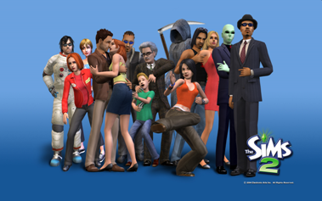
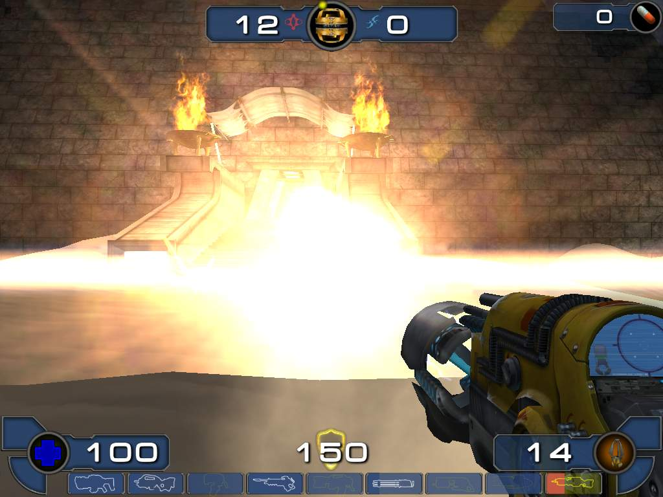
Personality
Computer anxiety
Gender
  Which games do women like?
  Pac-man, Donkey Kong, Tetris
  Why? (Hypotheses: less violent, quieter soundtracks, fully visible playing fields, softer colors, personality, closure/completeness)
  Can we measure this?
What current games are for women?
Style, pace, top-down/bottom-up, visual/audio learners, dense vs. sparse data

Slide 30
Personality
No simple taxonomy of user personality types. Ex. Myers-Briggs Type Indicator
  Extrovert vs. introvert
  Sensing vs. intuition
  Perceptive vs. judging
  Feeling vs. thinking
Weak link between personality types and interfaces
Think about your application, and see if user personality is important!
  Fighter jets vs. search engines

Slide 31
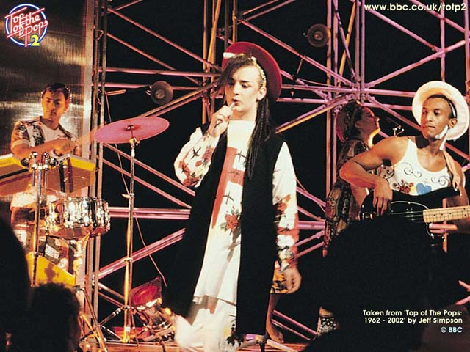
Cultural and International Diversity
Language
Date / Time conventions
Weights and Measures
Left-to-right
Directions (!)
Telephone #s and addresses
Names, titles, salutations
SSN, ID, passport
Sorting
Icons, buttons, colors
Etiquette
Evaluation:
  Local experts/usability studies

Slide 32
Users with Disabilities
Federal law to ensure access to IT, including computers and web sites. (1998 Amendment to Rehabilitation Act)
Disabilities
  Vision
    Blind (bill-reader)
    low-vision
    color-blind
  Hearing
    Deaf
    Limited hearing
  Mobility
  Learning
    Dyslexia
    Attention deficient, hemisphere specific, etc.
Keyboard and mouse alternatives
Color coding
Font-size

Slide 33
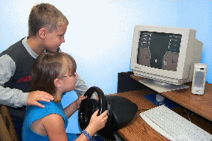
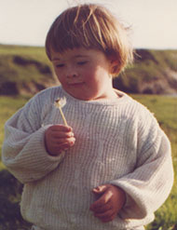
Users with Disabilities
Contrast
Text descriptors for web images
Screen magnification
Text to Speech (TTS) – JAWS (web pages)
  Check email on the road, in bright sunshine, riding a bike
Speech Recognition
Head mounted optical mice

Slide 34
Users with Disabilities
Eye Gaze control
Learning what helps those with disabilities affects everyone
  Present procedures, directions, and instructions accessible to even poor readers
  Design feedback sequences that explain the reason for error and help put users on the right track
  Reinforcement techniques with other devices
Good target area for a final project!

Slide 35
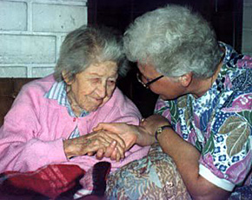
Elderly
Reduced
  Motor skills
  Perception
  Vision, hearing, touch, mobility
  Speed
  Memory
Other needs
  Technology experience is varied (How many grandmothers use email? mothers?)
  Uninformed on how technology could help them
  Practice skills (hand-eye, problem solving, etc.)
Touch screens, larger fonts, louder sounds

Slide 36
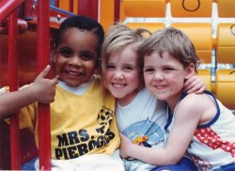
Children
Technology saviness?
Age changes much:
  Physical dexterity
    (double-clicking, click and drag, and small targets)
  Attention span
  (vaguely) Intelligence
Varied backgrounds (socio-economic)
Goals
  Educational acceleration
  Socialization with peers
  Psychological - improve self-image, self-confidence
  Creativity – art, music, etc. exploration

Slide 37
Children
Teenagers are a special group
  Next generation
  Beta test new interfaces, trends
  Cell phones, text messages, simulations, fantasy games, virtual worlds
Requires Safety
They
  Like exploring (easy to reset state)
  Don’t mind making mistakes
  Like familiar characters and repetition (ever had to babysit a kid with an Ice Age DVD?)
  Don’t like patronizing comments, inappropriate humor
Design: Focus groups

Slide 38
Accommodating Hardware and Software Diversity
Support a wide range of hardware and software platforms
Software and hardware evolution
  OS, application, browsers, capabilities
  backward compatibility is a good goal
Three major technical challenges are:
  Producing satisfying and effective Internet interaction (broadband vs. dial-up & wireless)
  Enabling web services from large to small (size and resolution)
  Support easy maintenance of or automatic conversion to multiple languages

Slide 39
HCI Goals
Influence academic and industrial researchers
  Understand a problem and related theory
  Hypothesis and testing
  Study design (we’ll do this!)
  Interpret results
Provide tools, techniques and knowledge for commercial developers
  competitive advantage (think ipod)
Raising the computer consciousness of the general public
  Reduce computer anxiety (error messages)
  Common fears:
    I’ll break it
    I’ll make a mistake
    The computer is smarter than me
  HCI contributes to this!

Slide 40
Near & Future Interfaces
Time to learn
Speed of performance
Rate of errors
Retention over time
Subjective satisfaction
Let’s review
Minority Report
Steel Battalion
Eye Toy
Dance Dance Revolution
Nintendo Wii

